Slide 1

REMMZ
Responsible Expenditures, Made More Zen
Hackathon 2026
OPEN PAYMENTS

Slide 2
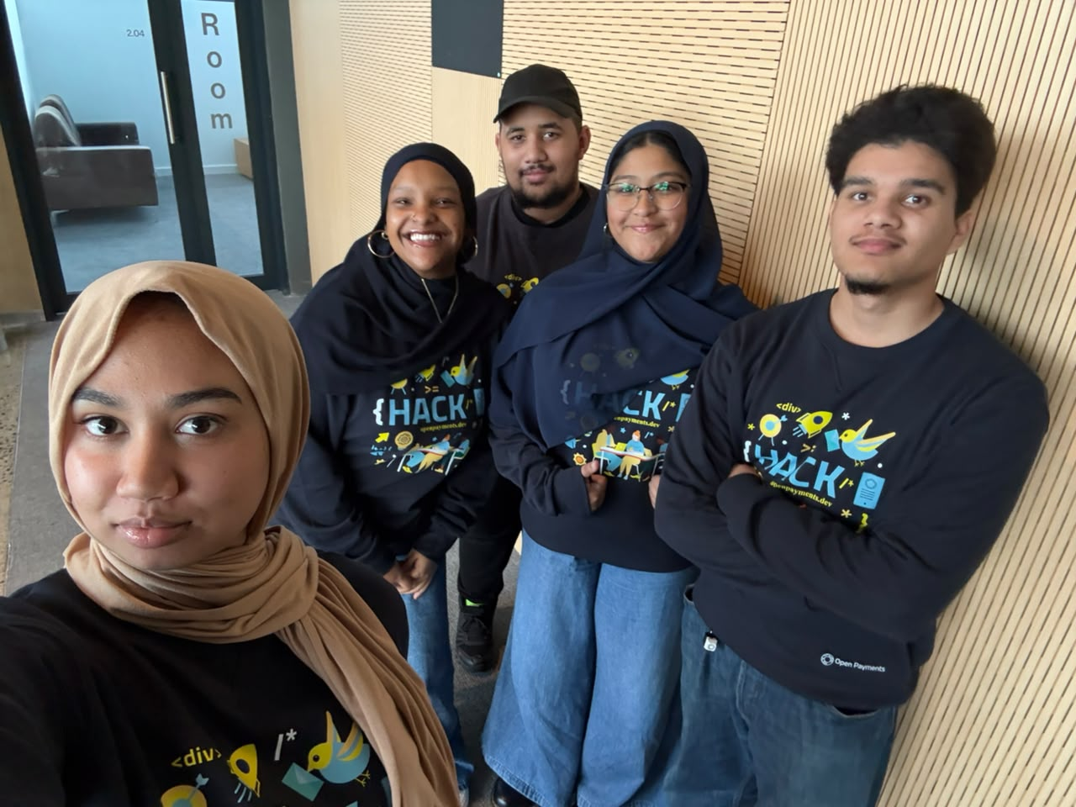
Meet the team
Misha Dick
Entisaar Elfadl
Mikaeel Naidoo
Zahra Salie
Moegamat Rashaad Samsodien

Slide 3
Problem statement
Millions of South Africans with non traditional incomes, including students, gig workers, freelancers, and informal workers, are excluded from building a credit history and accessing financial opportunities.
As students, we've experienced the challenge of being financially responsible while remaining invisible to the credit system. So we built a BNPL platform that allows students to graduate with more than just a degree, but a financial identity as well.

Slide 4
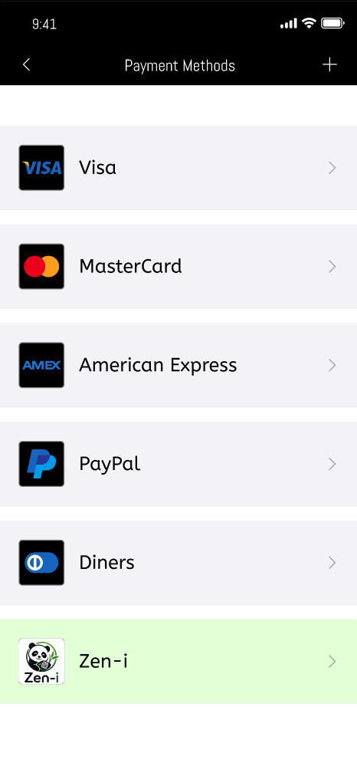
Solution
Our Buy Now, Pay Later platform is unique as it is built specifically for students and flexible income earners, especially for users with no credit history.
It turns BNPL repayments into pathway for building credit.
Uses Open Payments for secure, seamless repayments.
Rewards responsible repayment, not just a person’s employment status.
Creates a fairer alternative to traditional credit scoring.

Slide 5
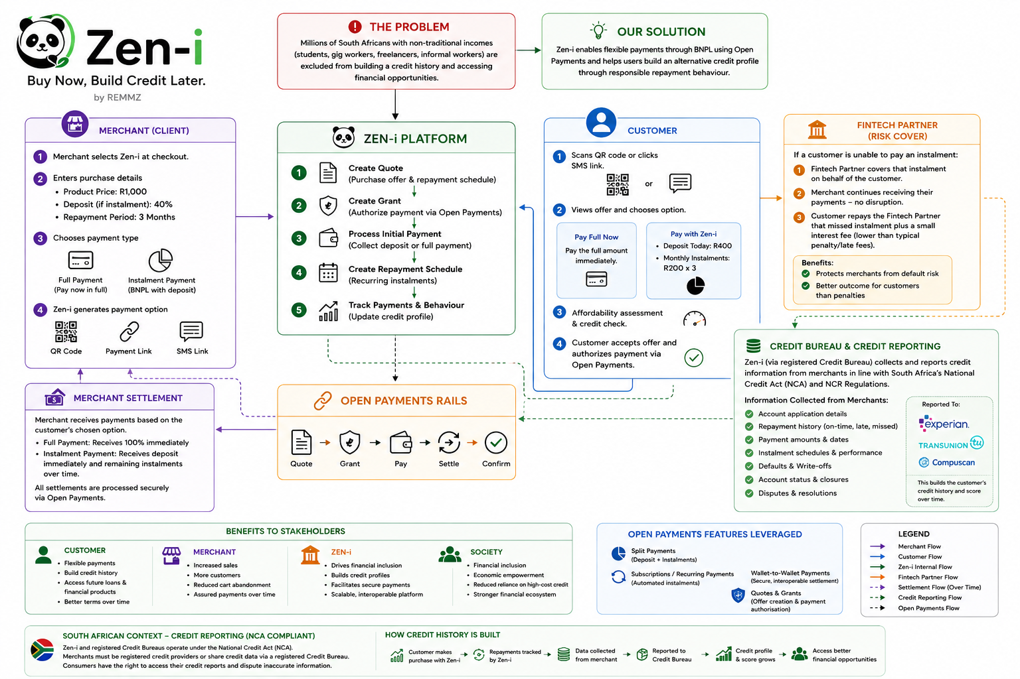

Slide 6
Demo
{Showcase a demo of your project [max 2 min]
Tip: pre-record it in case of technical difficulties on stage BUT live demo is preferred}

Slide 7
Conclusion
Our solution solves our problems as students.
We're starting with students because we understand these challenges firsthand. But this is only the beginning. Our vision is to expand Zen-i to support freelancers, gig workers, and anyone with a flexible income, giving more people a fair opportunity to build credit through responsible financial behaviour.

Slide 8
Let's make all make our finances a little more Zen. Thank you.

